Slide 1
Course 227 Lab 4 & 5 –CST Microwave Studio Microstrip Lines
Dr Harry Marks
h.marks@lancaster.ac.uk

Slide 2
Objectives:
Learn how to set up a PCB simulation in CST
Simulate a microstrip waveguide.
Learn how to set up ports.
Collect data about the reflection and transmission via the S-parameters.
Understand how to view the E-fields throughout the structure.
Simulate a filter.
Learn how to insert a load.
Learn how to generate a quarter wave transformer for impedance matching.

Slide 3
Tasks to Include in your Report:
Show 3D model of your microstrip and stub filter.
Show a plot of your S11.
Show a screenshot of your original microstrip without the stub filter. Include the extra section of microstrip for matching purposes. Include in the picture the custom load.
Tune your microstrip such that there is impedance matching at the assigned frequency to your assigned load. Provide all the details of the quarter wave microstrip in your report, including of course the load and frequency you were assigned.
Show calculations made to perform the matching.
Include the plot of S11 of your matched circuit.

Slide 4
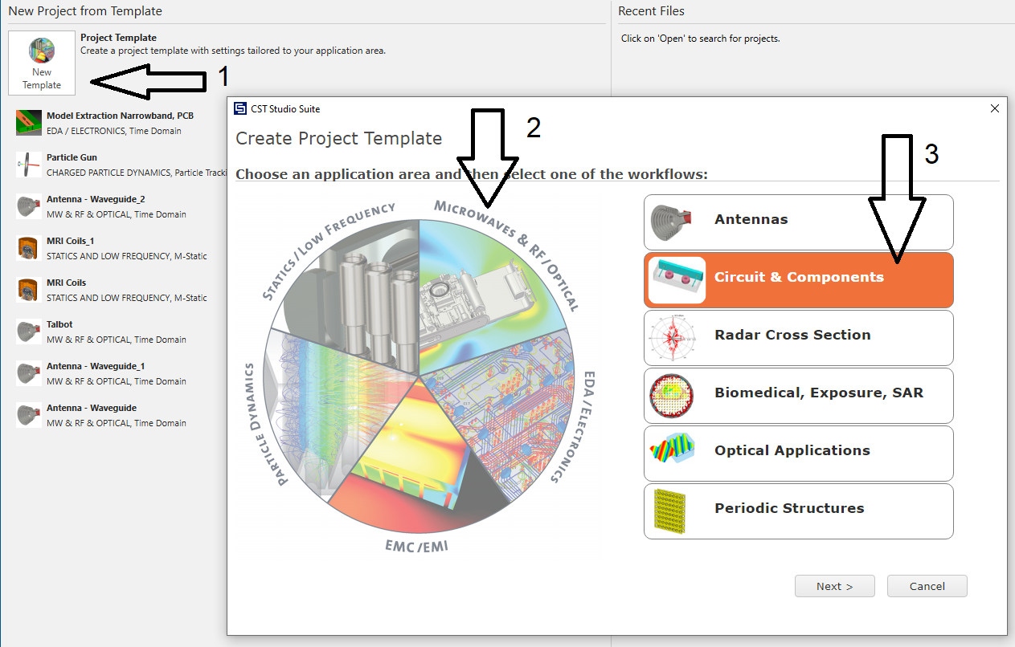

Slide 5
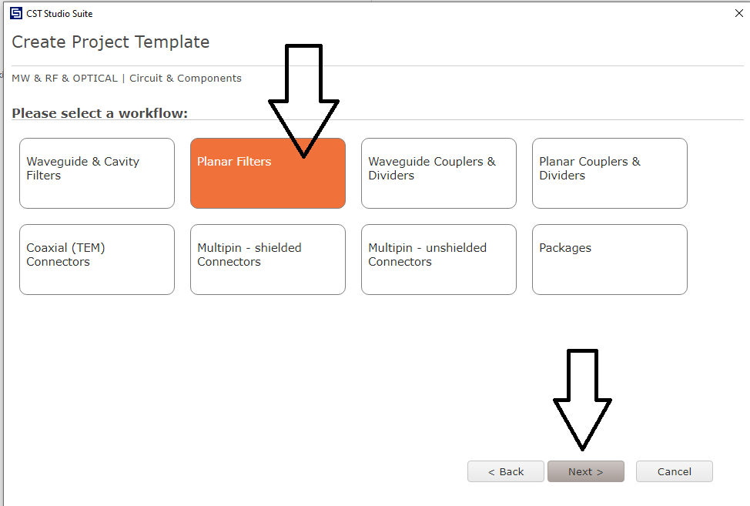

Slide 6
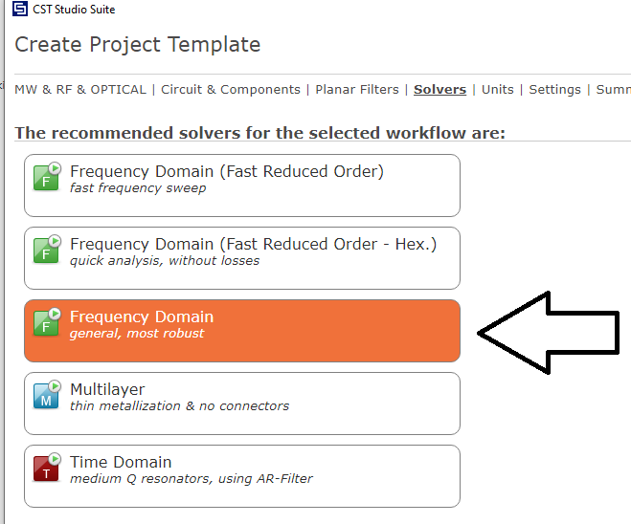
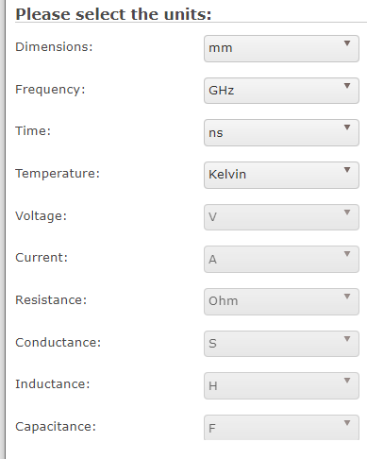

Slide 7
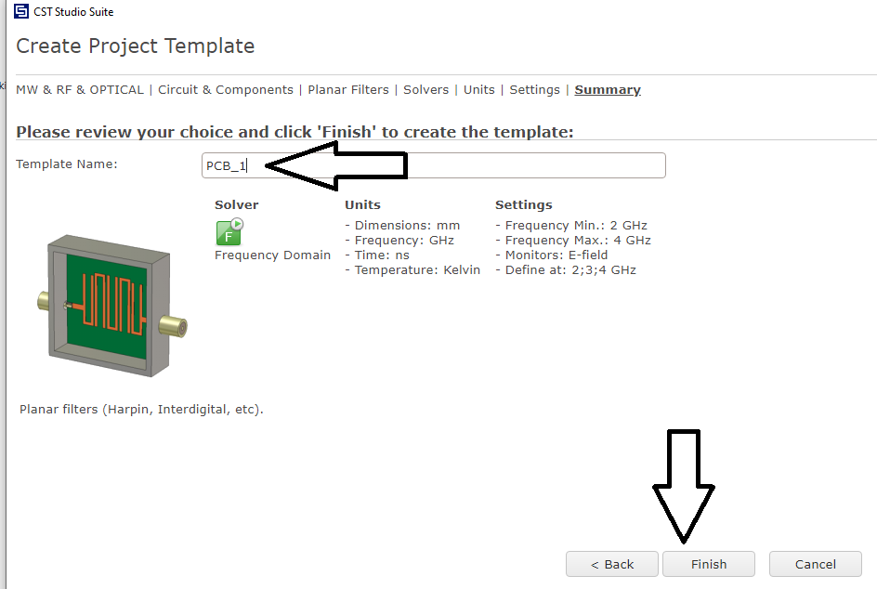
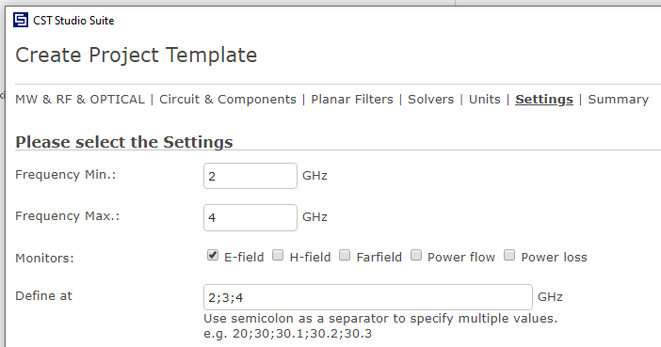

Slide 8

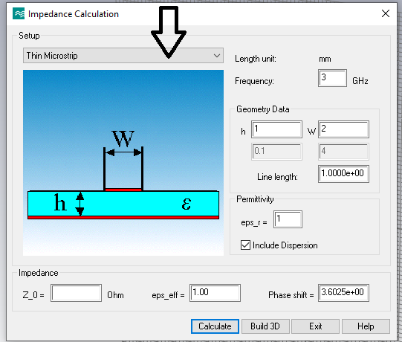

Slide 9


Slide 10
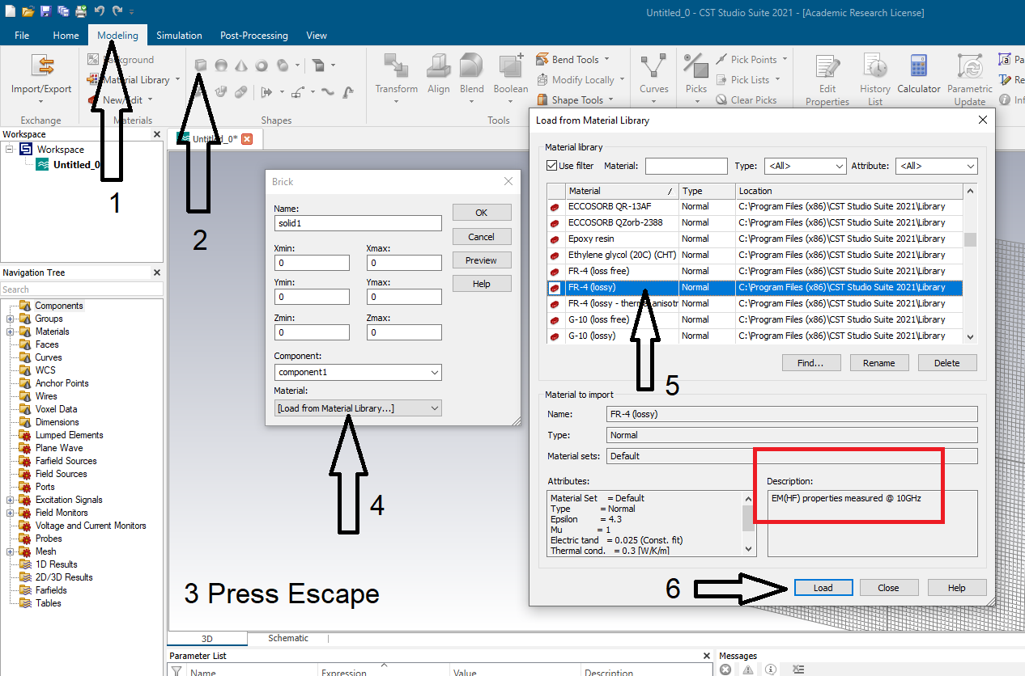

Slide 11
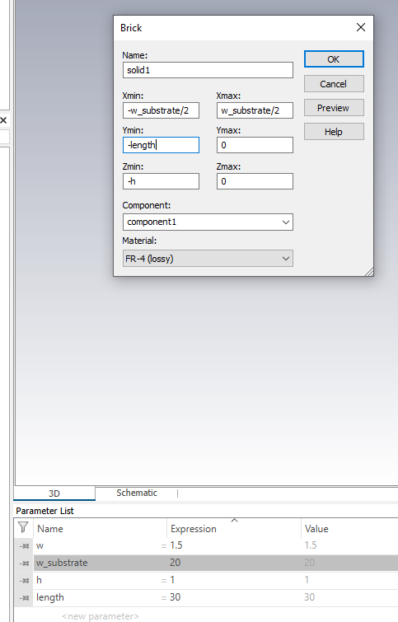
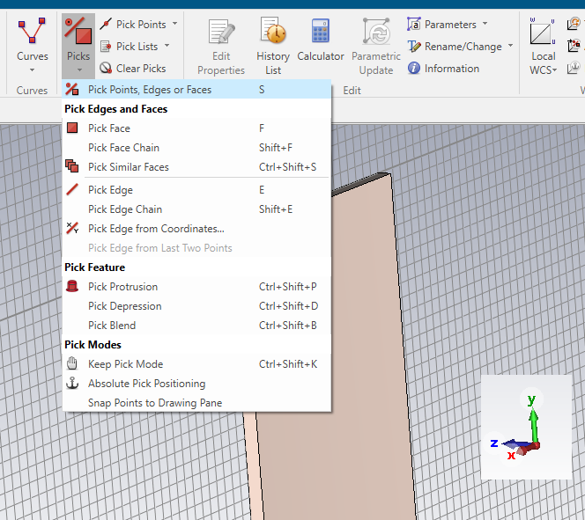

Slide 12
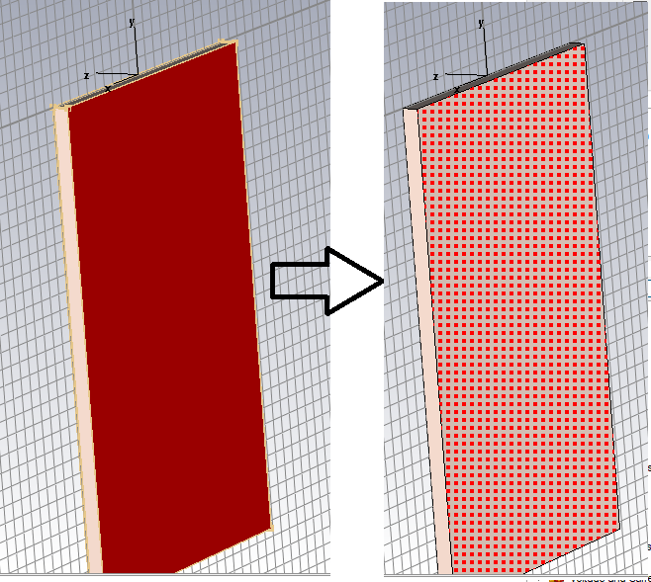

Slide 13
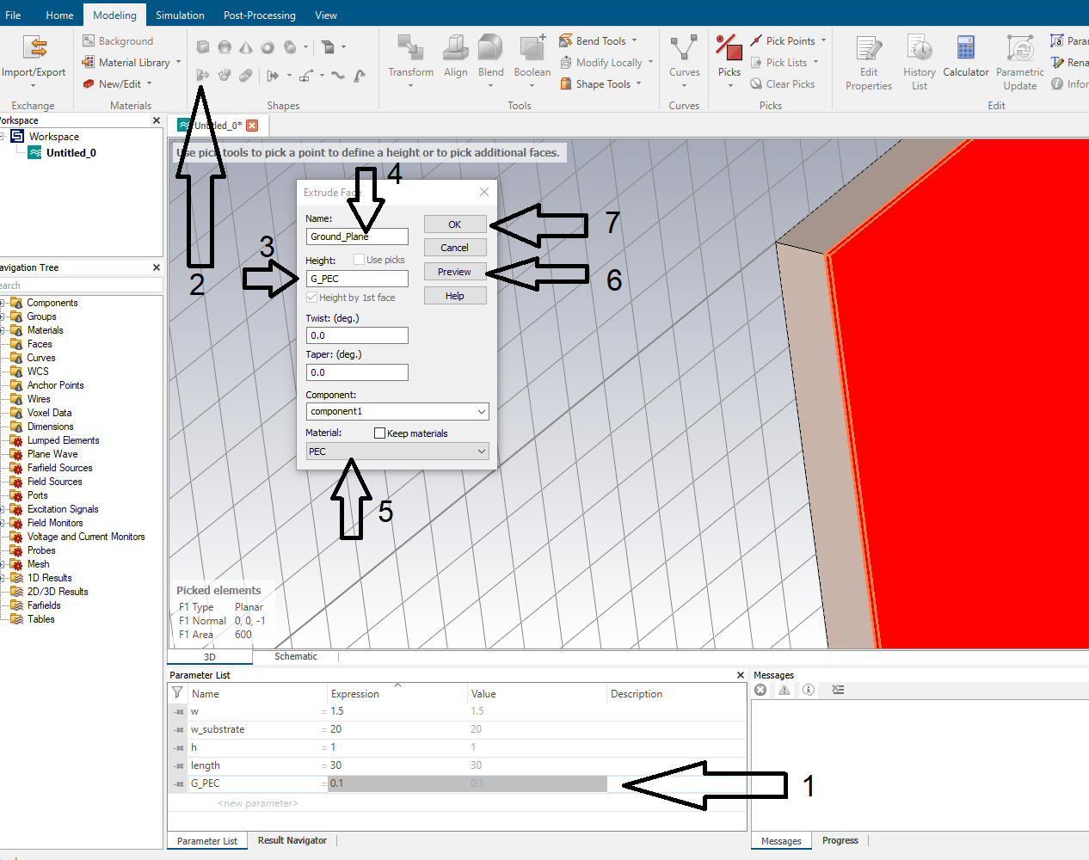

Slide 14
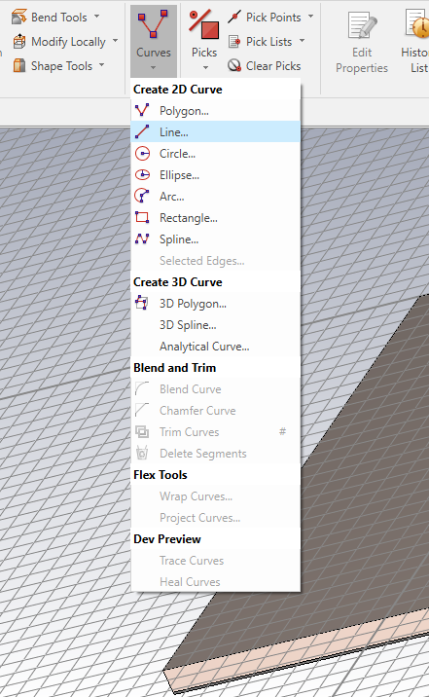
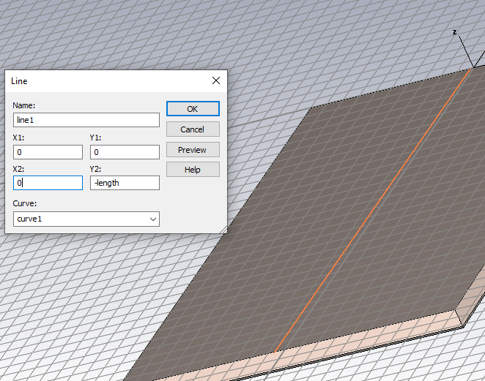

Slide 15
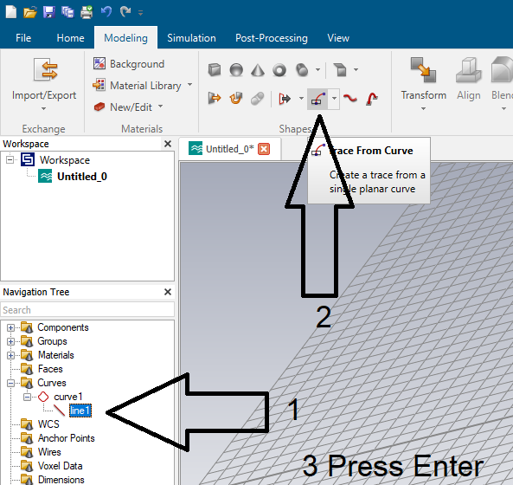

Slide 16
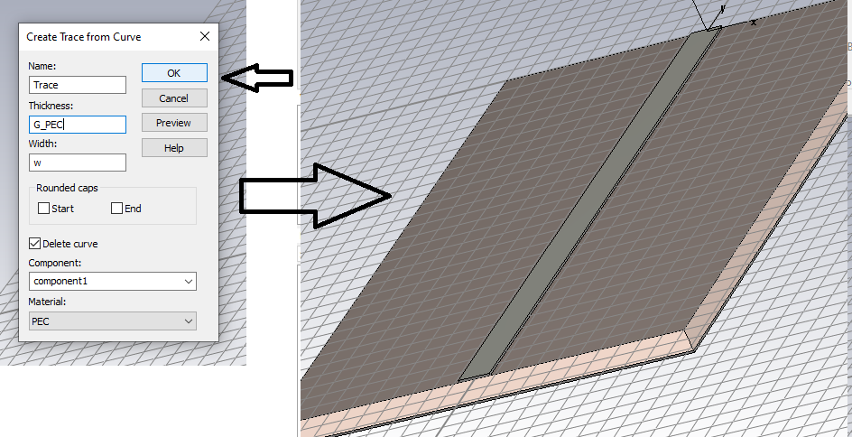

Slide 17
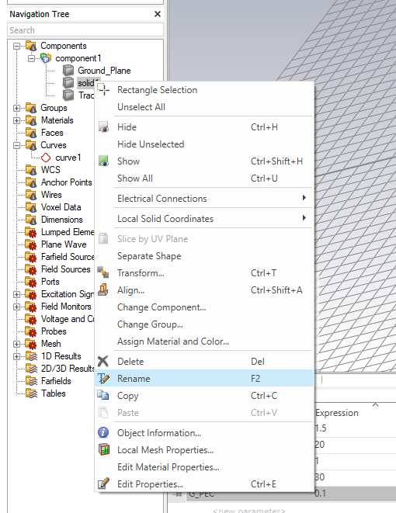
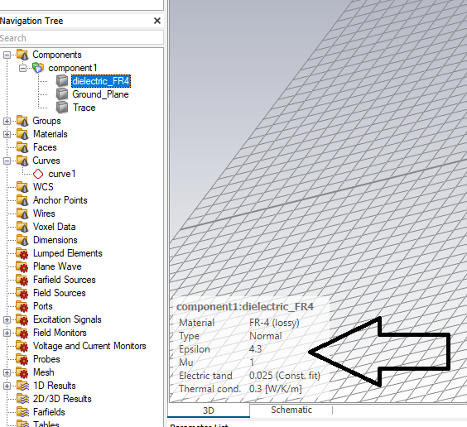

Slide 18
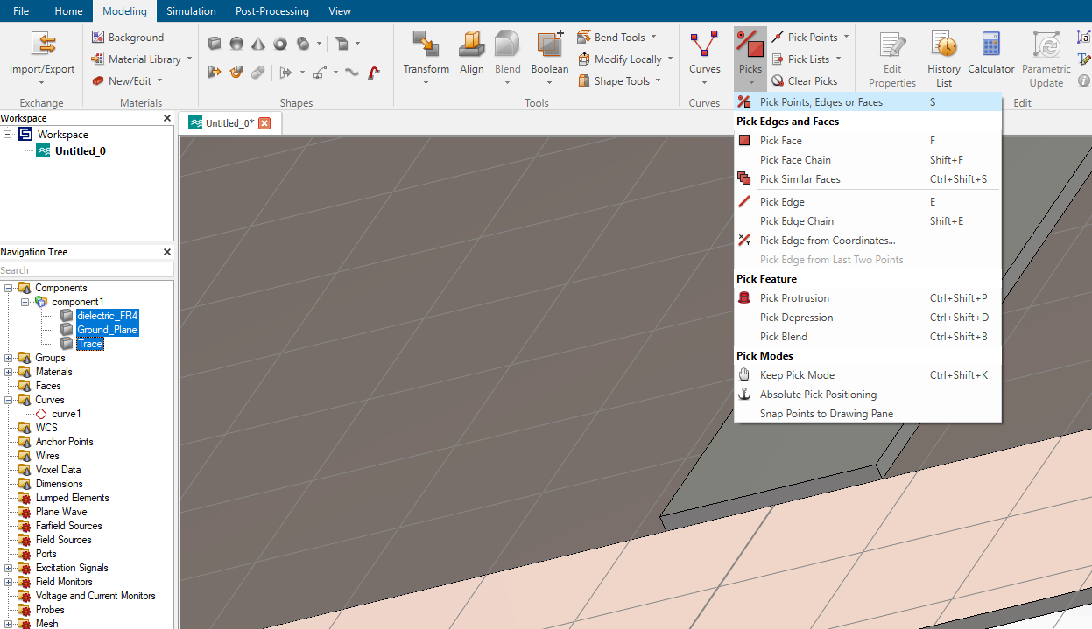

Slide 19
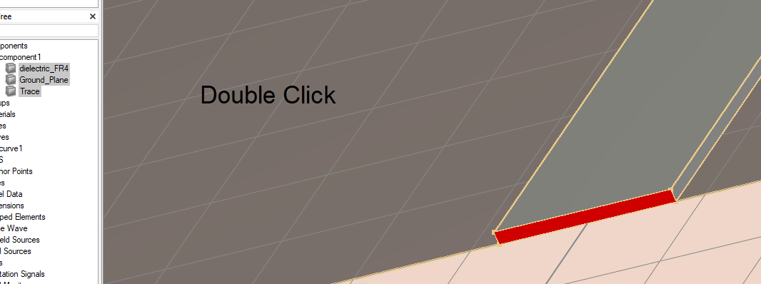

Slide 20
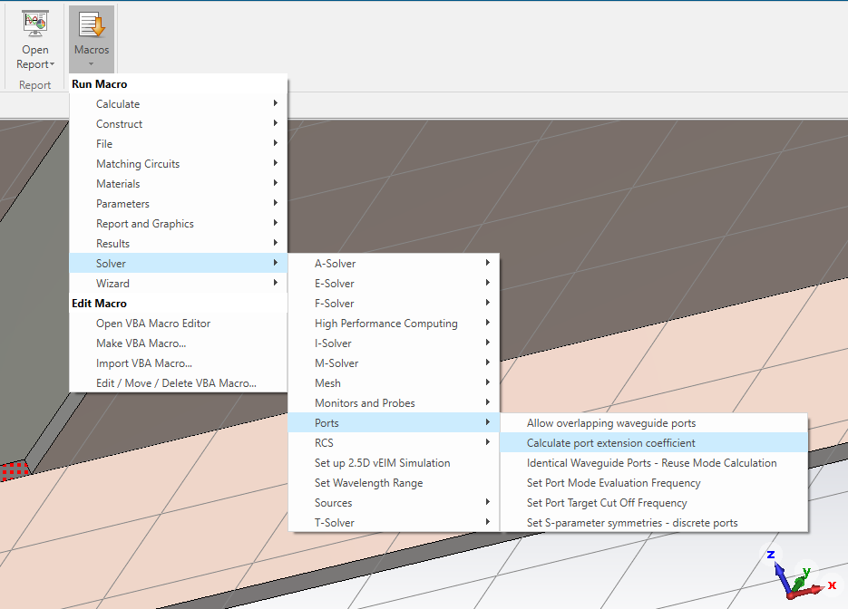

Slide 21
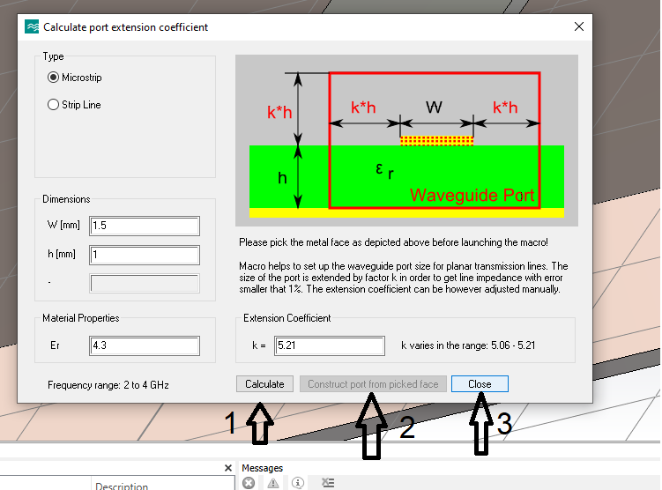

Slide 22
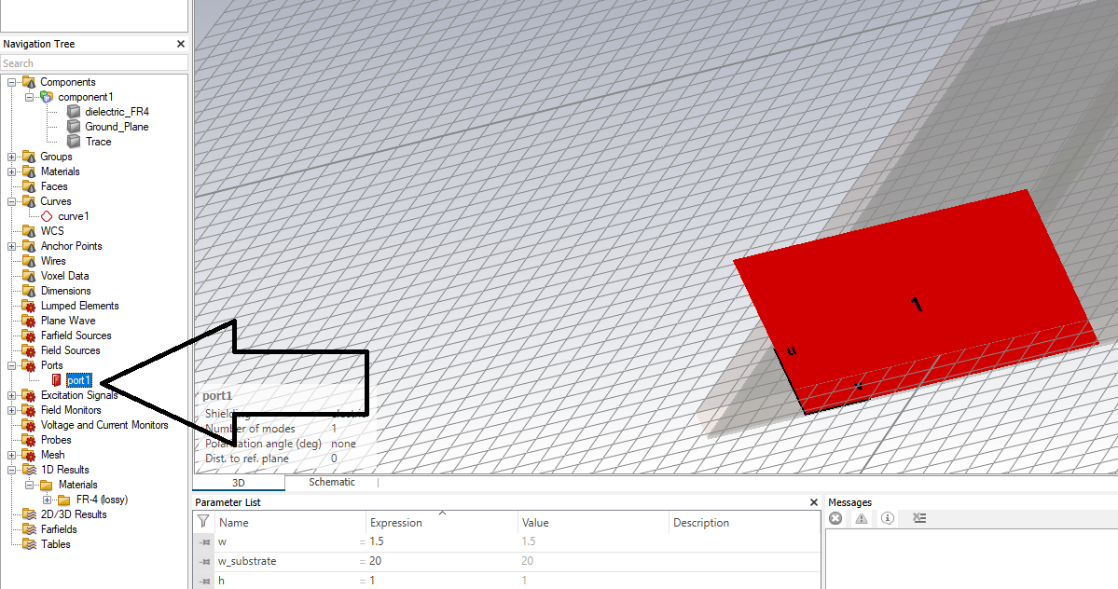

Slide 23
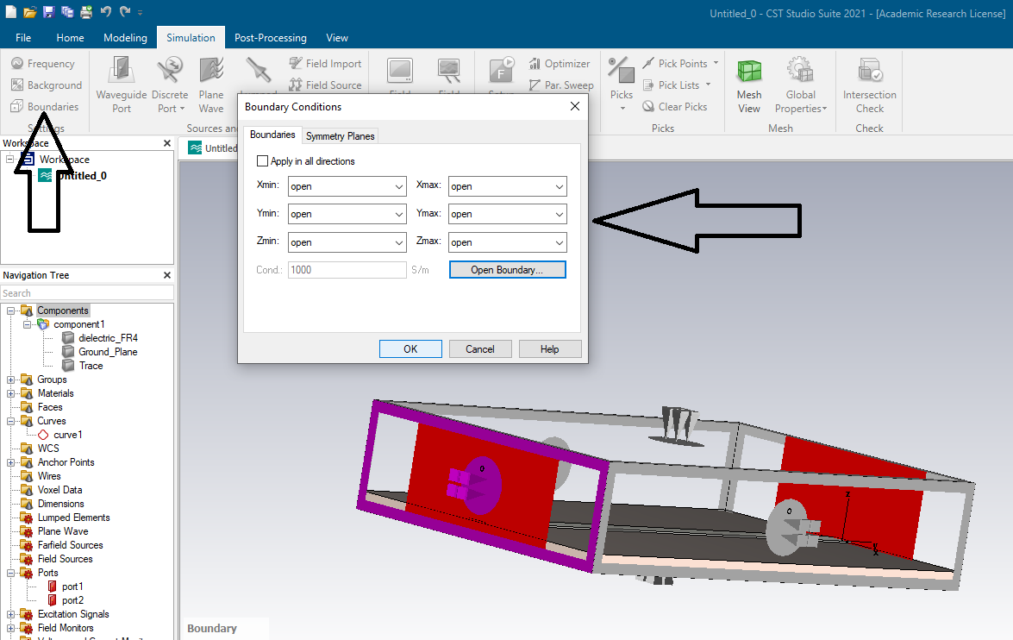

Slide 24
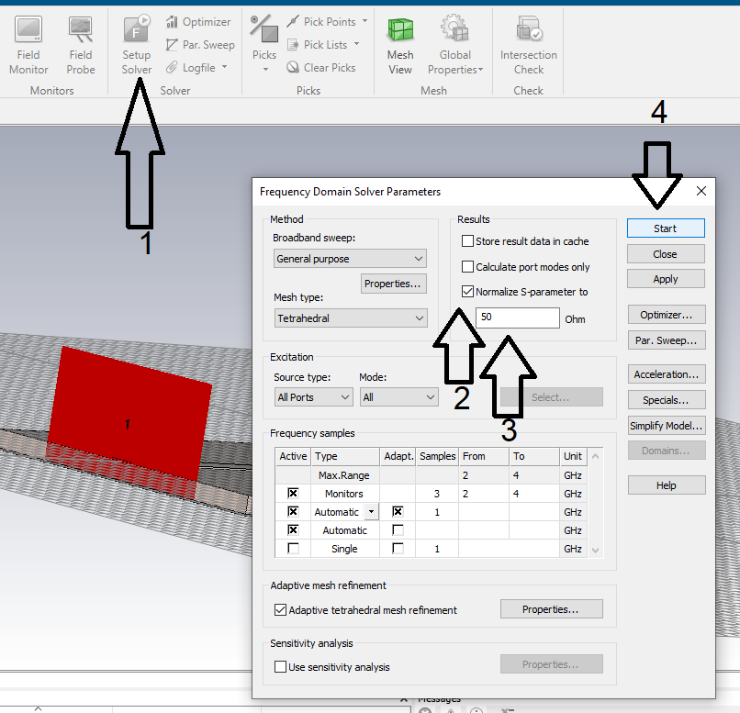

Slide 25
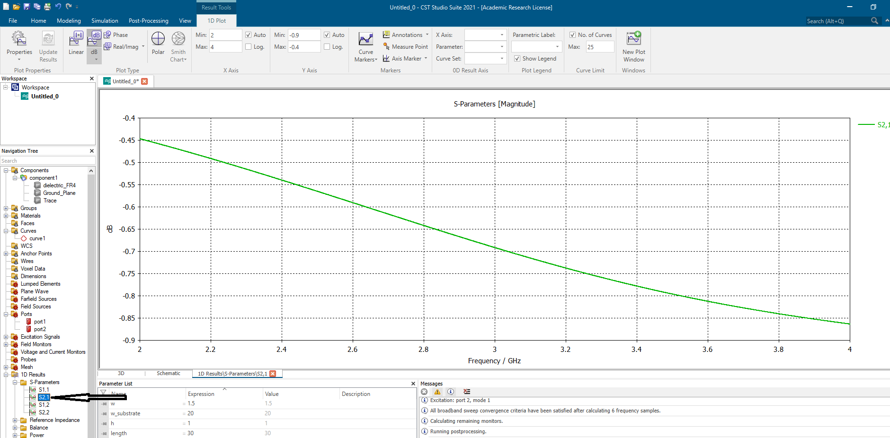

Slide 26
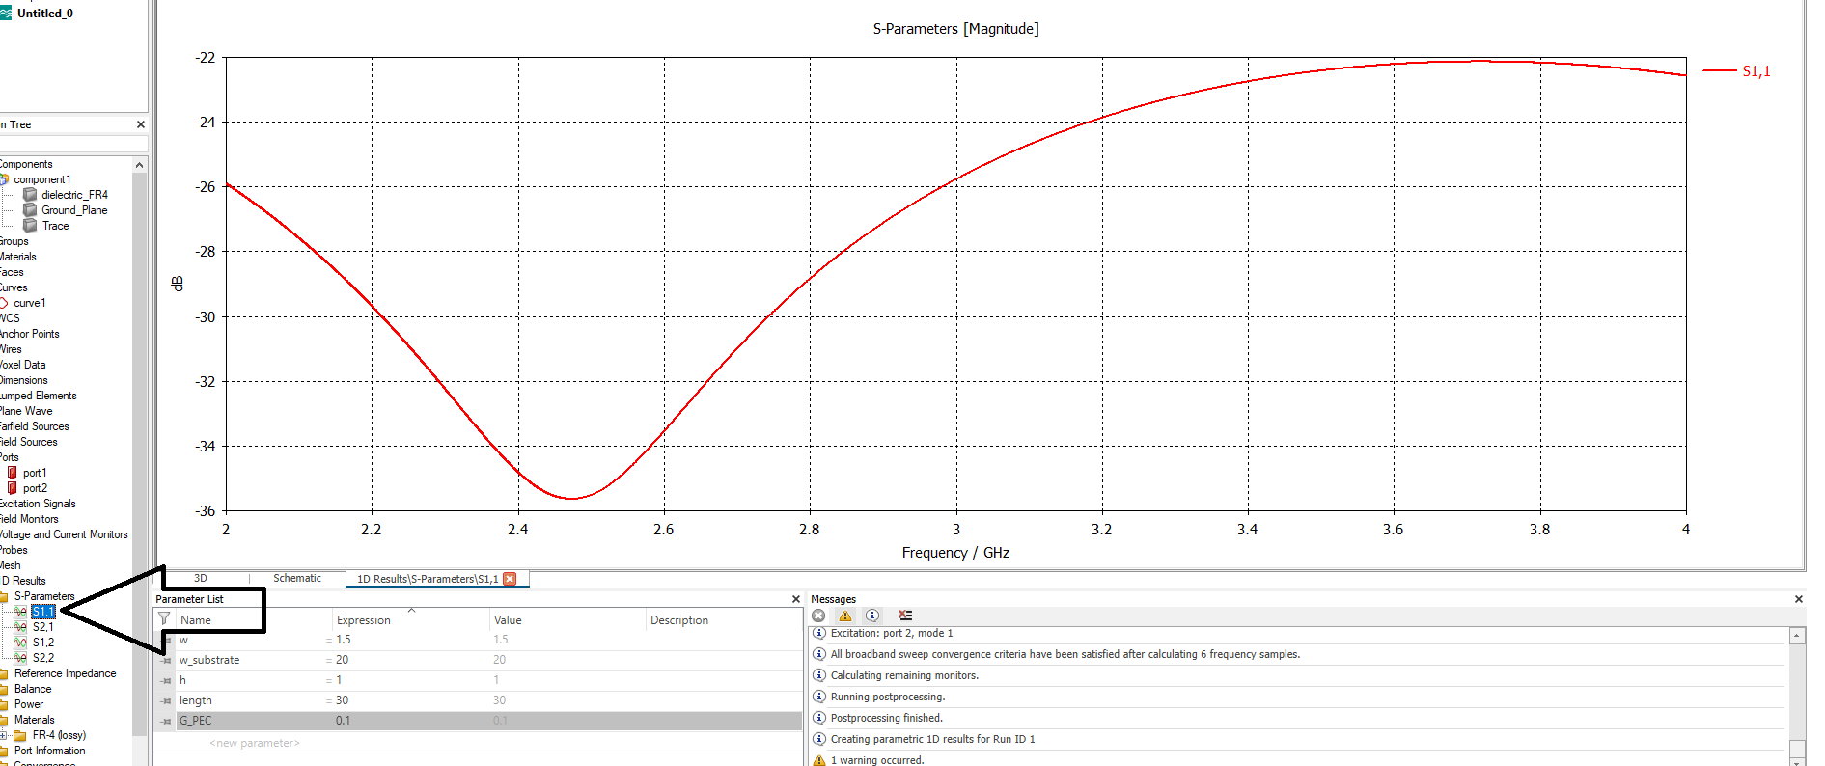

Slide 27
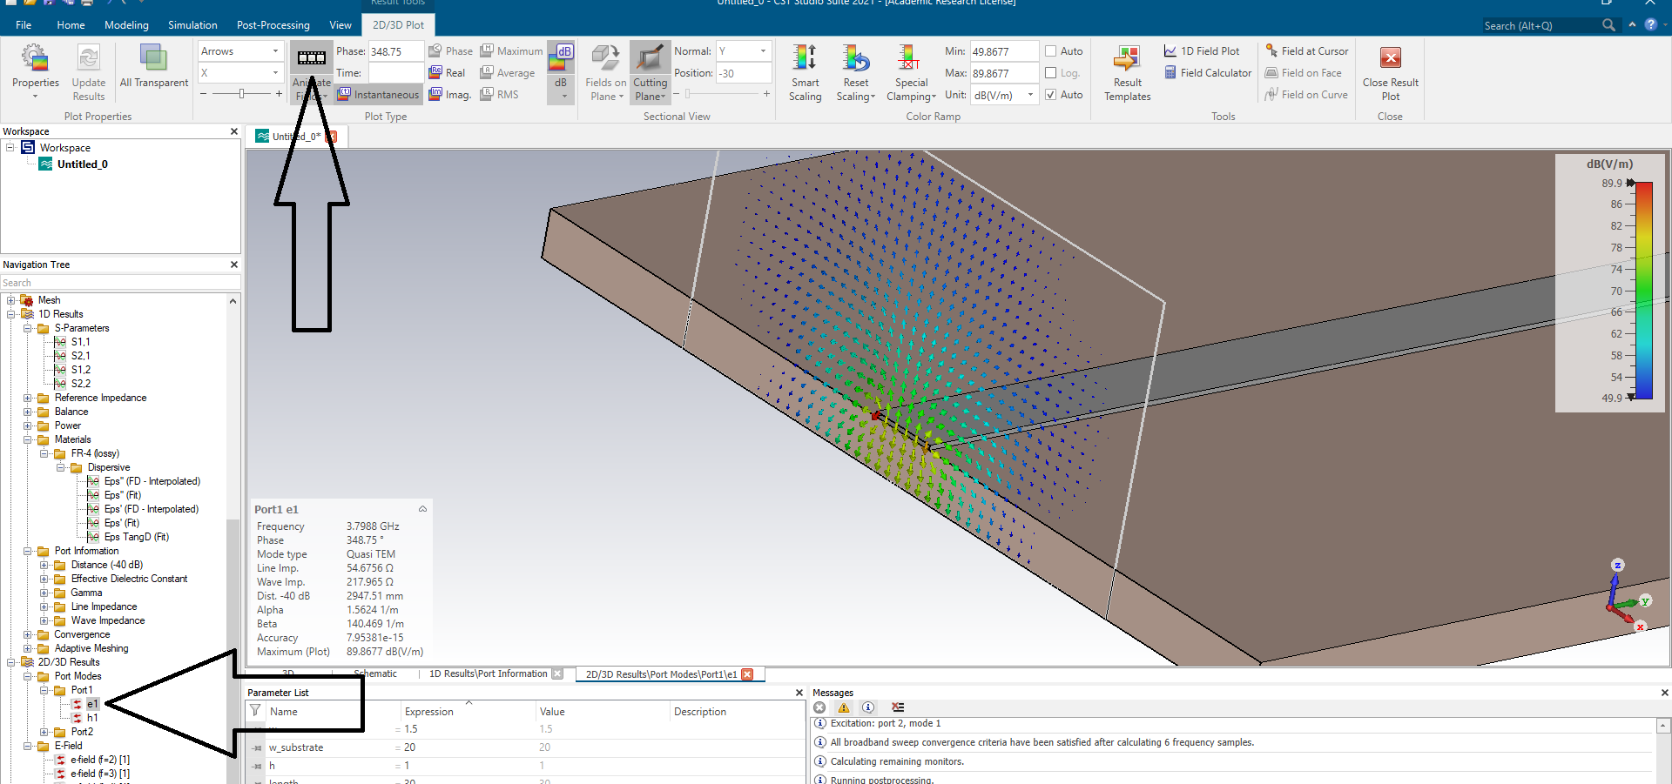

Slide 28
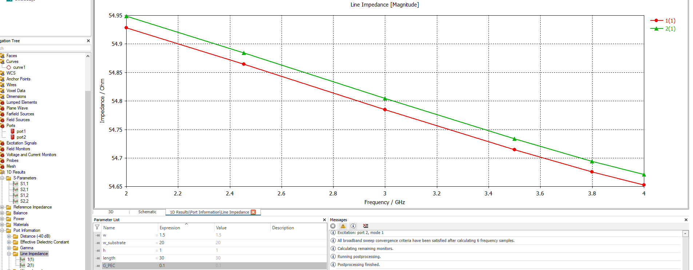

Slide 29
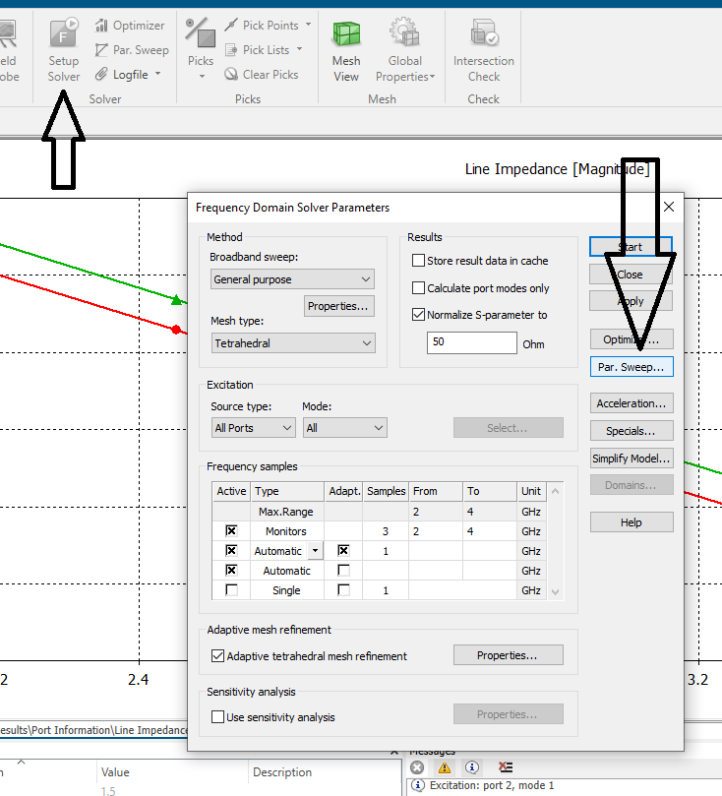

Slide 30
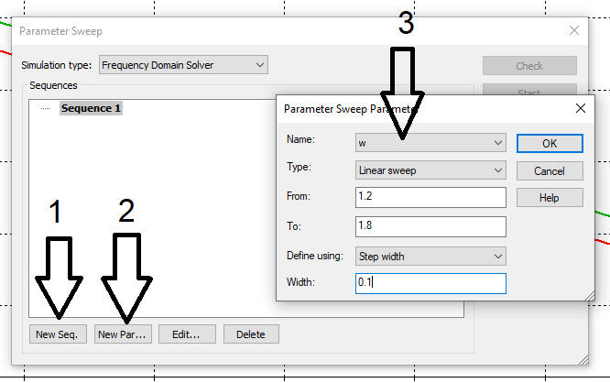
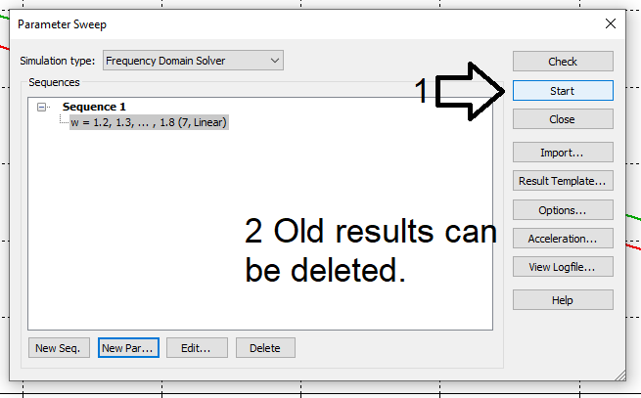

Slide 31
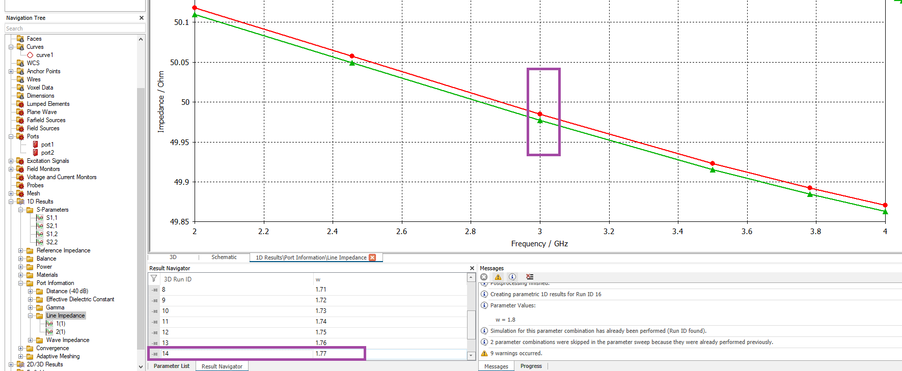

Slide 32
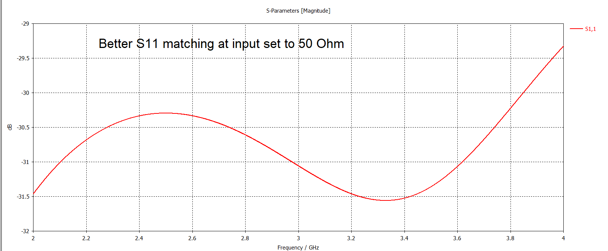

Slide 33
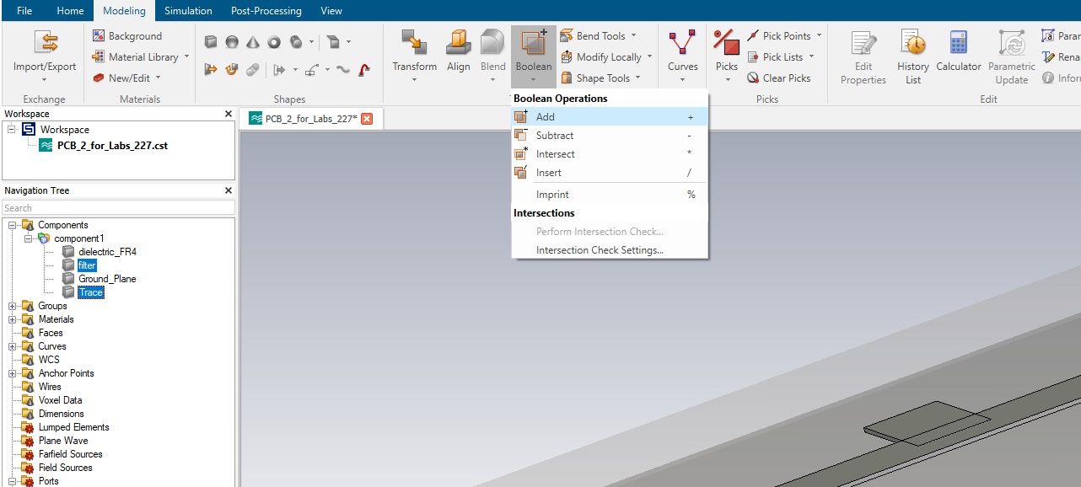

Slide 34
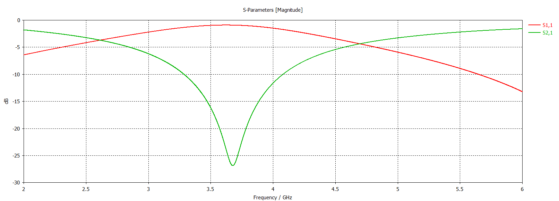

Slide 35
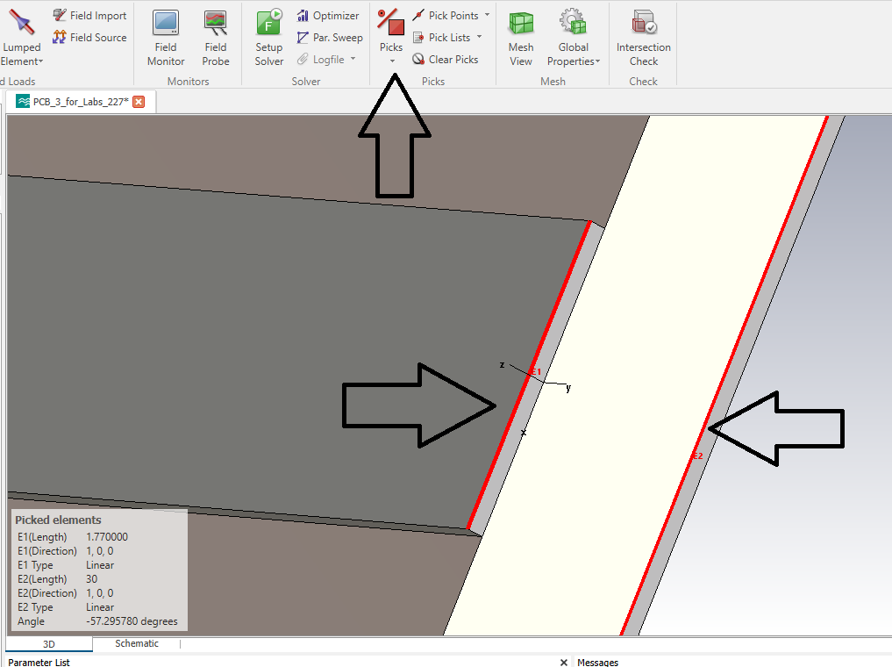

Slide 36
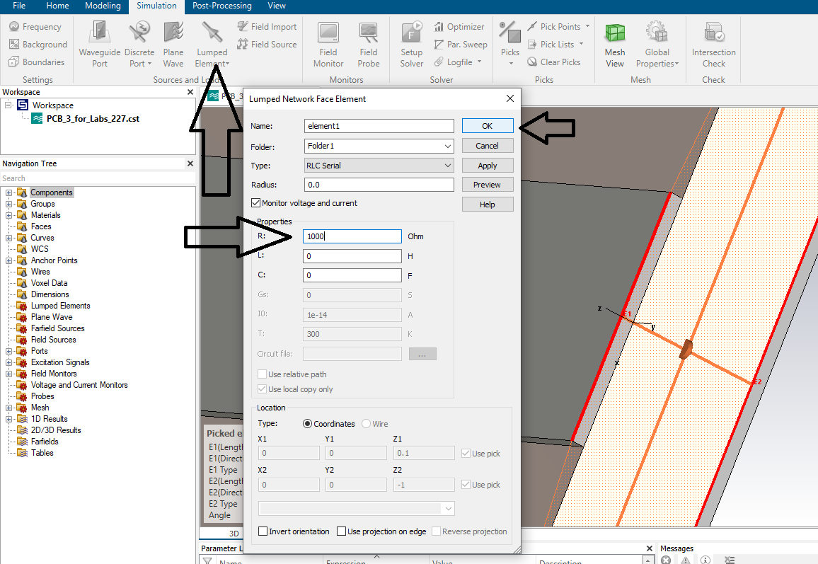

Slide 37
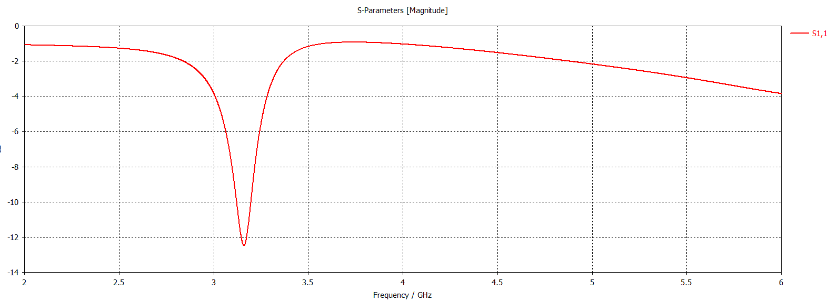

Slide 38
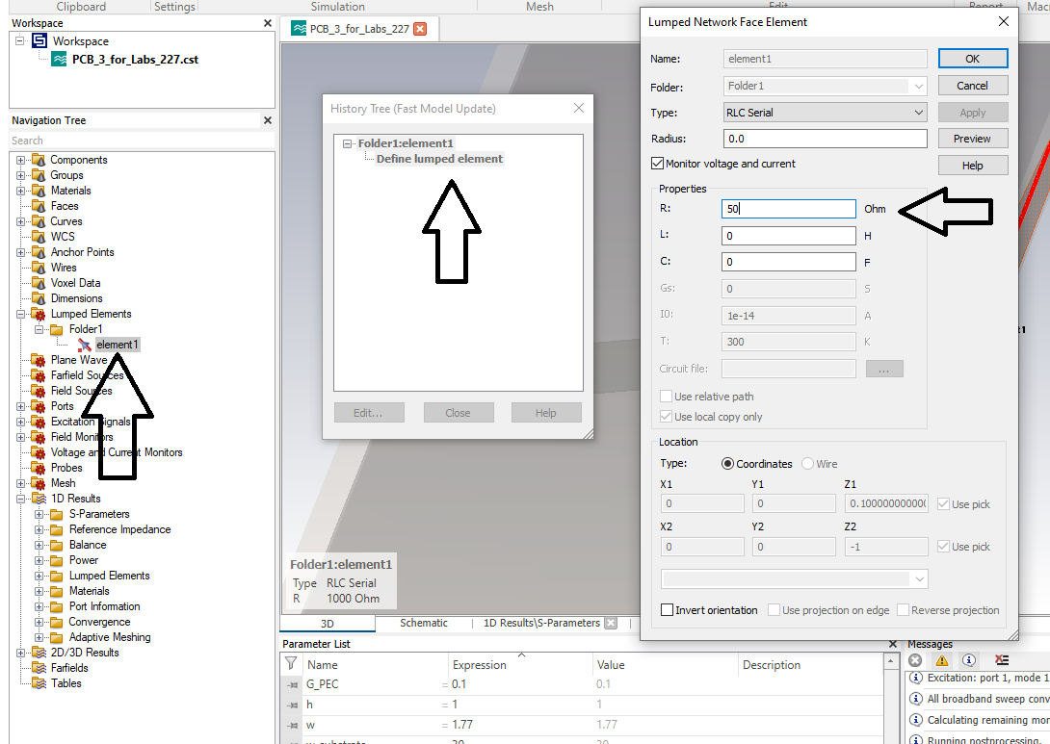

Slide 39
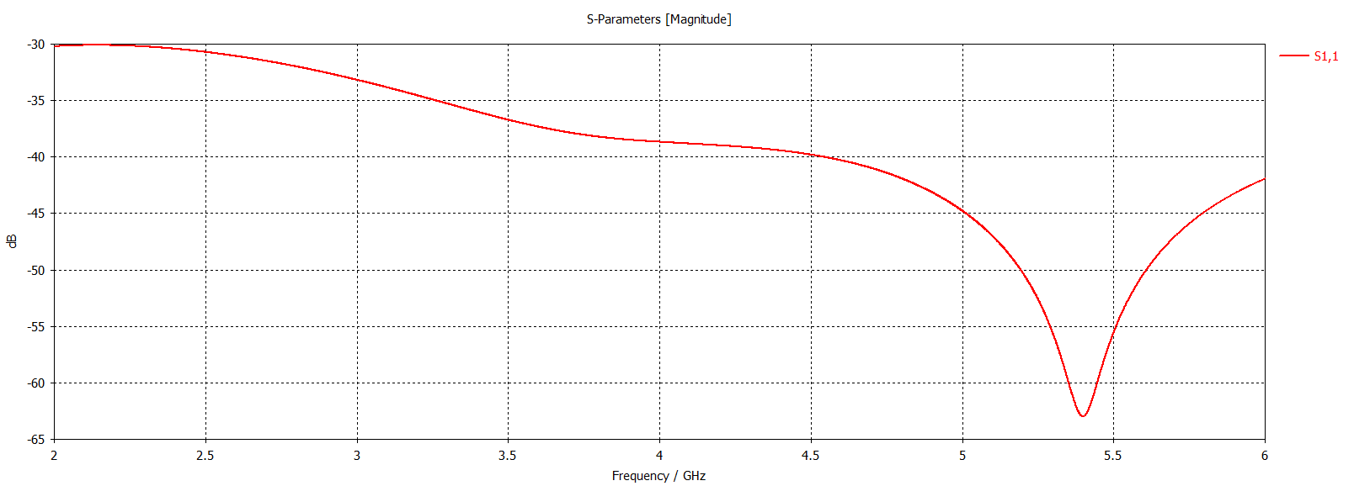
Delete the filter element so you are just working with a straight PCB line

Slide 40
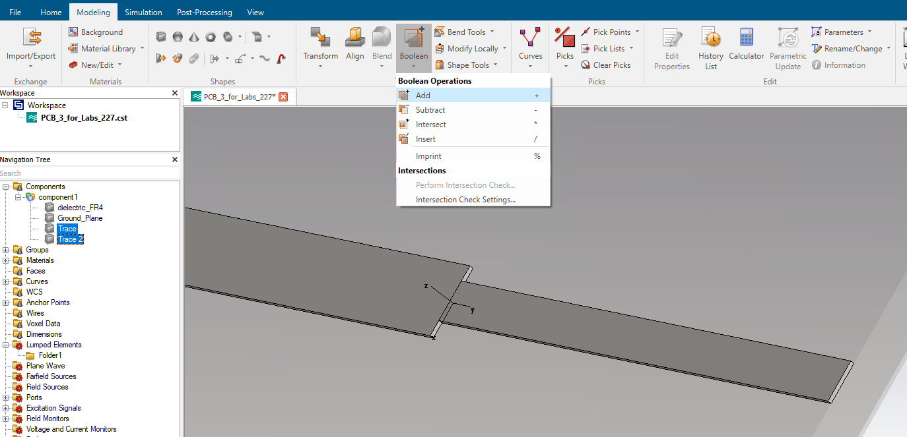

Slide 41
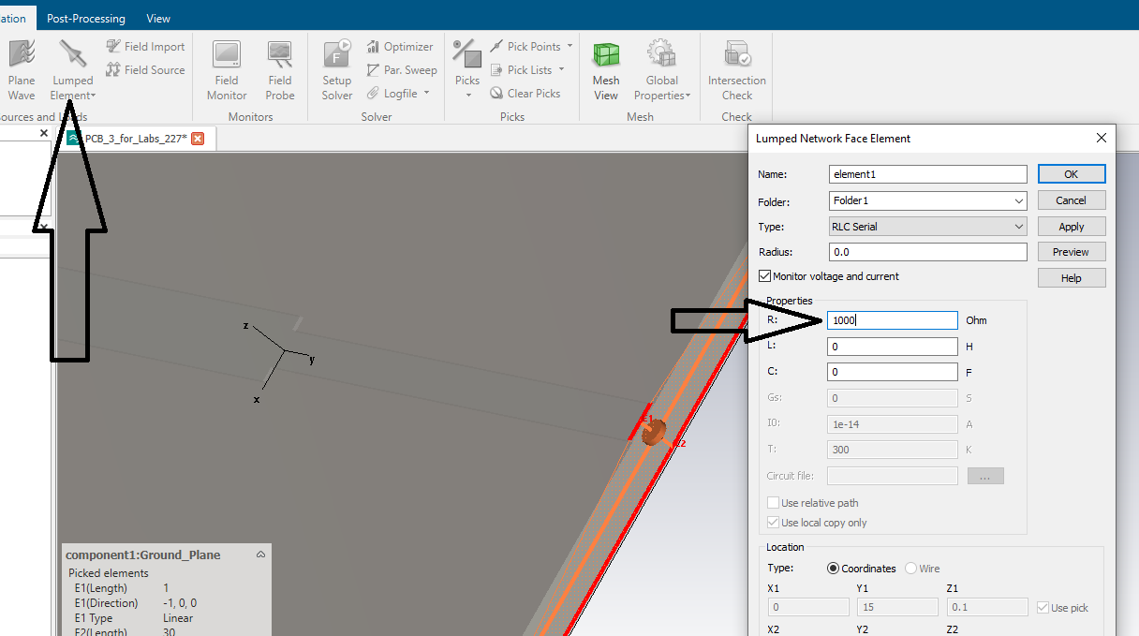

Slide 42
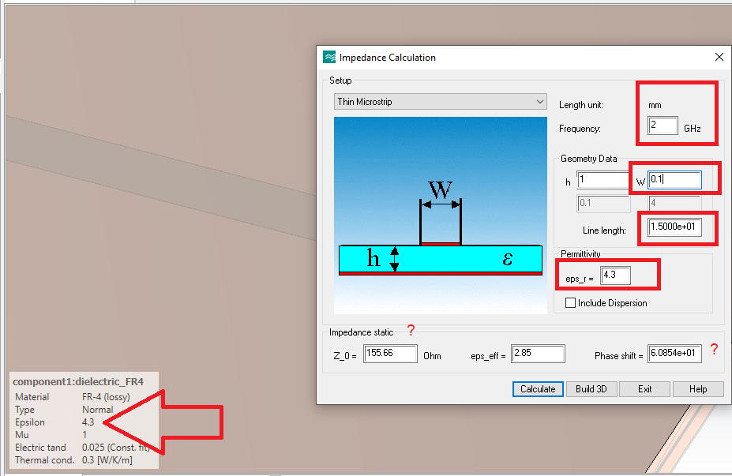

Slide 43
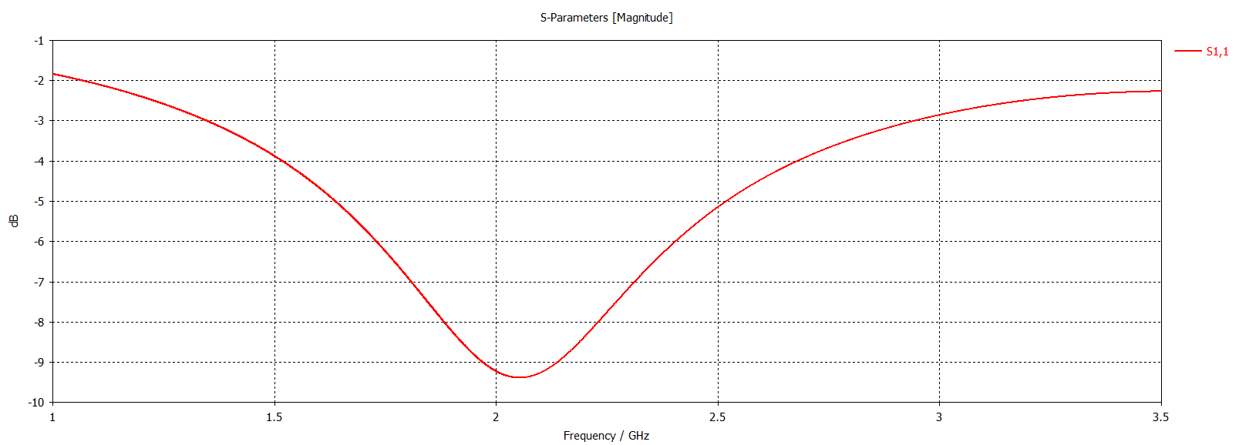

Slide 44


